Slide 1


Lecture 12-13: Basic Neural Nets Deep Feedforward Networks CS 109B, STAT 121B, AC 209B, CSE 109B
Mark Glickman and Pavlos Protopapas

Slide 2
http://video.arstechnica.com/watch/sunspring-sci-fi-short-film

Slide 3

Today’s news

Slide 4
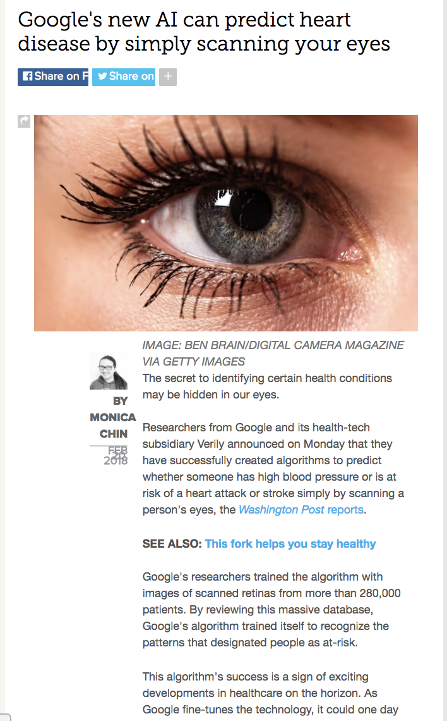

Slide 5
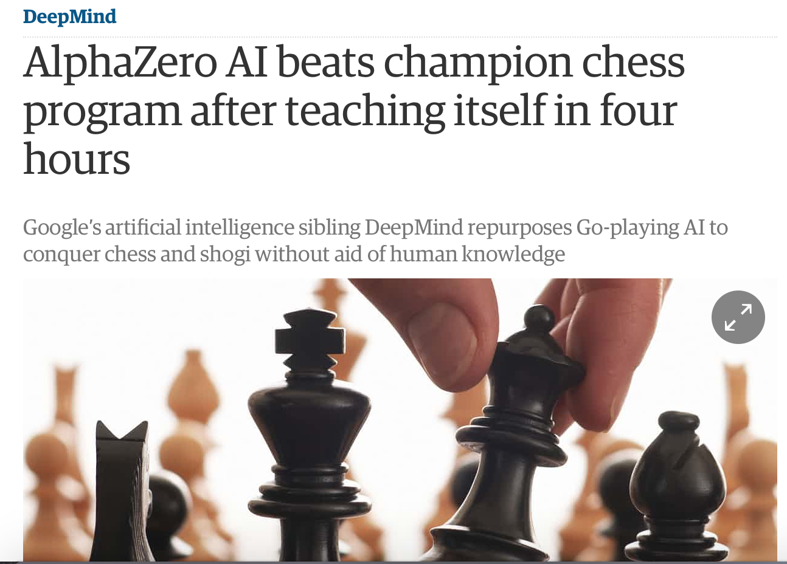
AlphaZero (2017)
theguardian.com

Slide 6
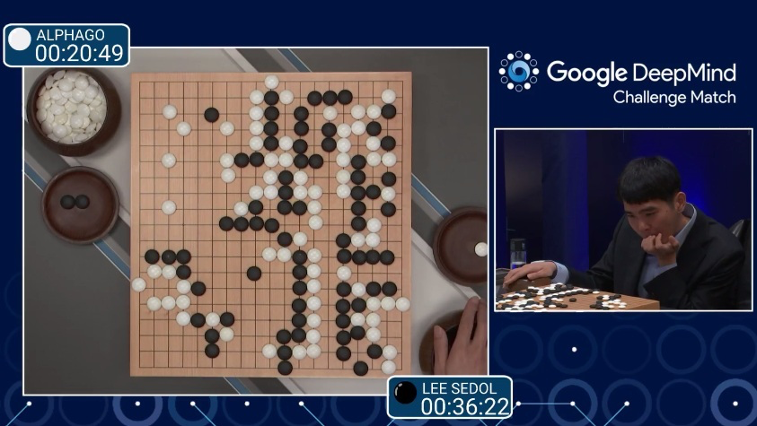
AlphaGo (2015)
First program to beat a professional Go player
Notes:
https://www.youtube.com/watch?v=PQCrX1sQSzY

Slide 7
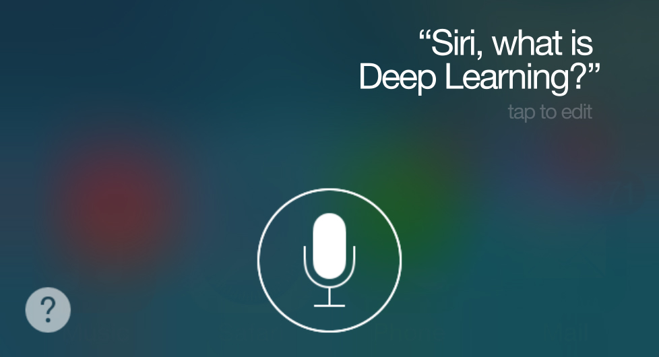
iOS Speech Synthesis (2016-)
Trained from 20 hours of high quality speech
machinelearning.apple.com
Notes:
https://machinelearning.apple.com/2017/08/06/siri-voices.html

Slide 8
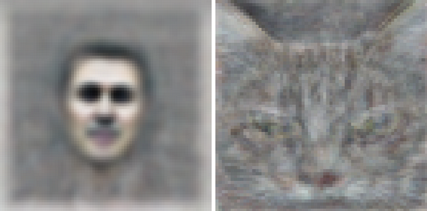
Google Brain (2012)
Differentiate between human face and cat
Neural network with 1 billion connections
10 million 200x200 pixel images from YouTube
Le et al., ICML 2012

Slide 9
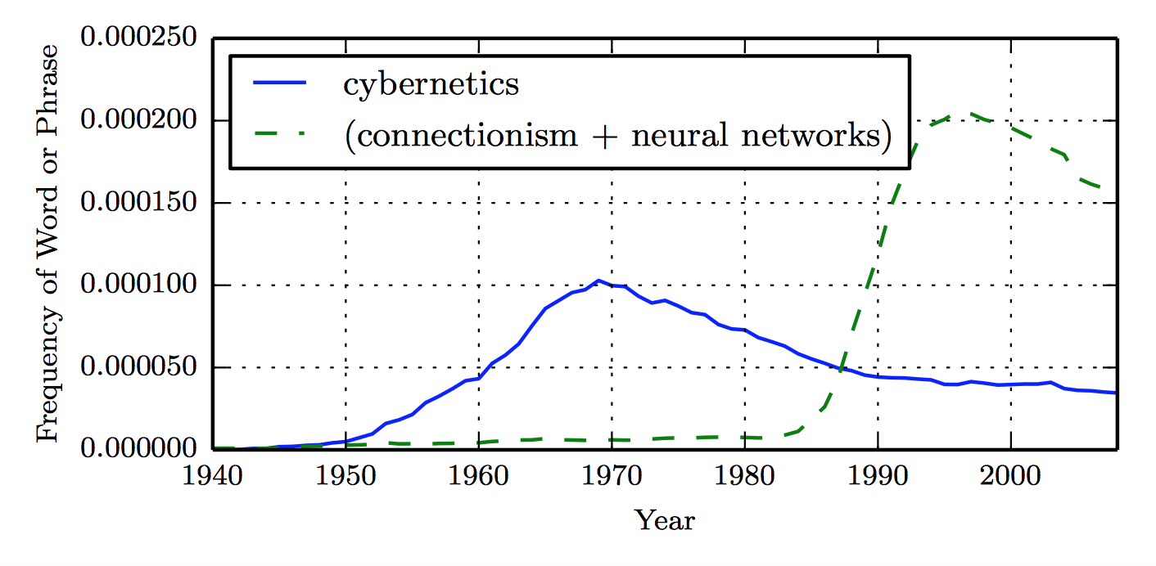
Historical Trends
LSTM
Distributed
Representation
Perceptron
Backprop
ADALINE
(Goodfellow 2016)

Slide 10
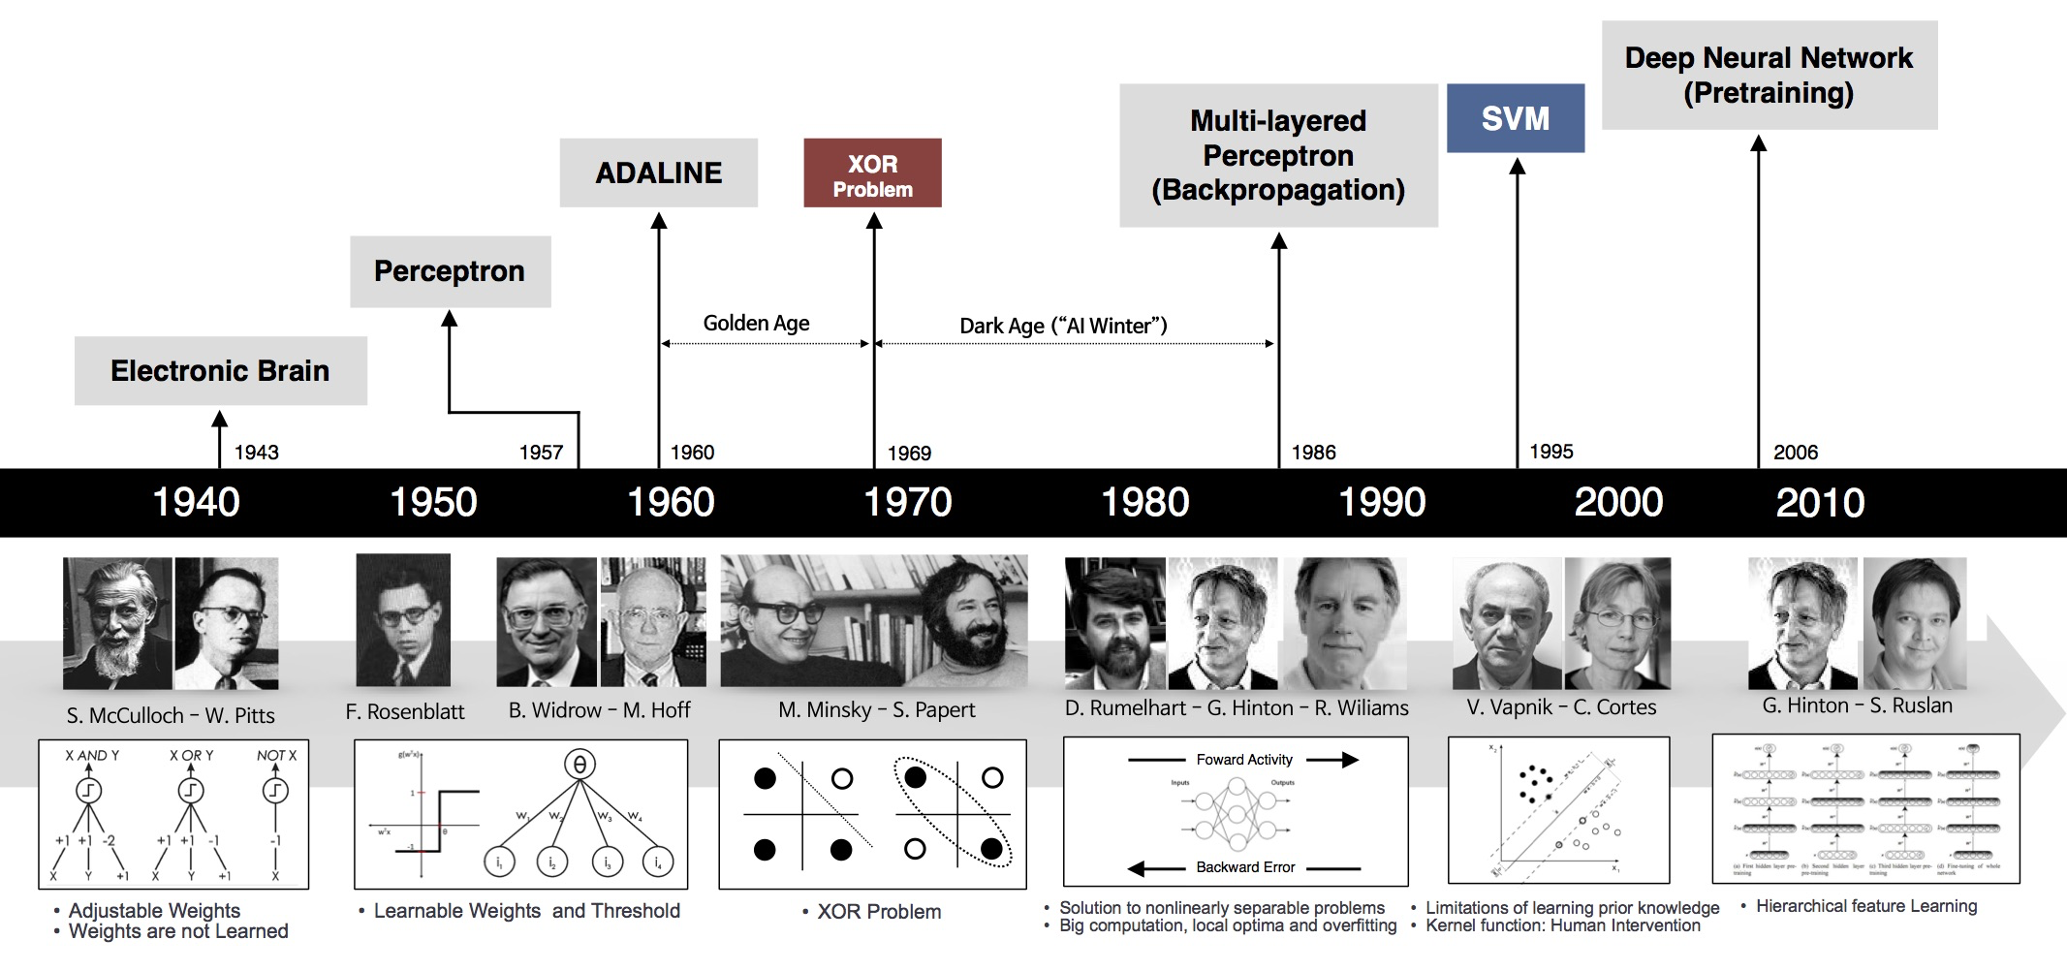
Historical Trends
beamandrew.github.io/
Notes:
https://beamandrew.github.io/deeplearning/2017/02/23/deep_learning_101_part1.html

Slide 11
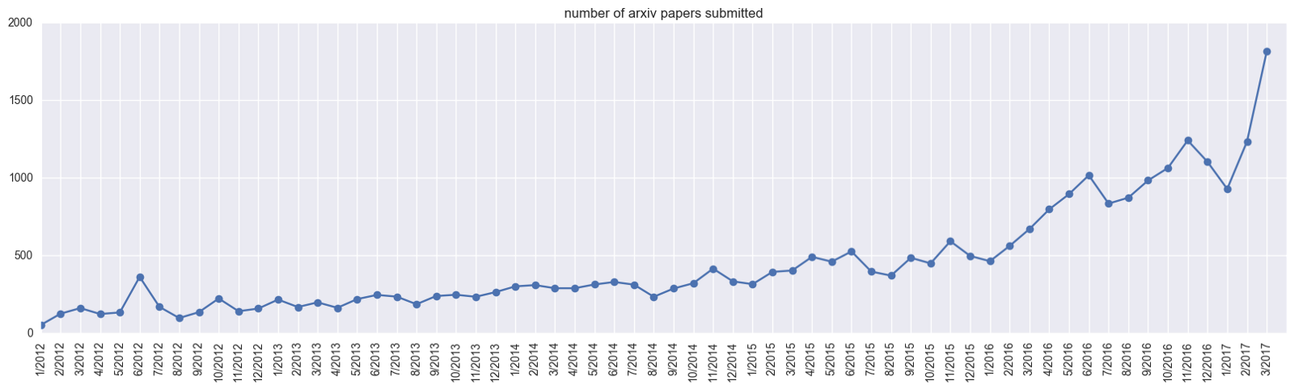
Historical Trends
ArXiv papers on deep learning: 2012-2017

Slide 12
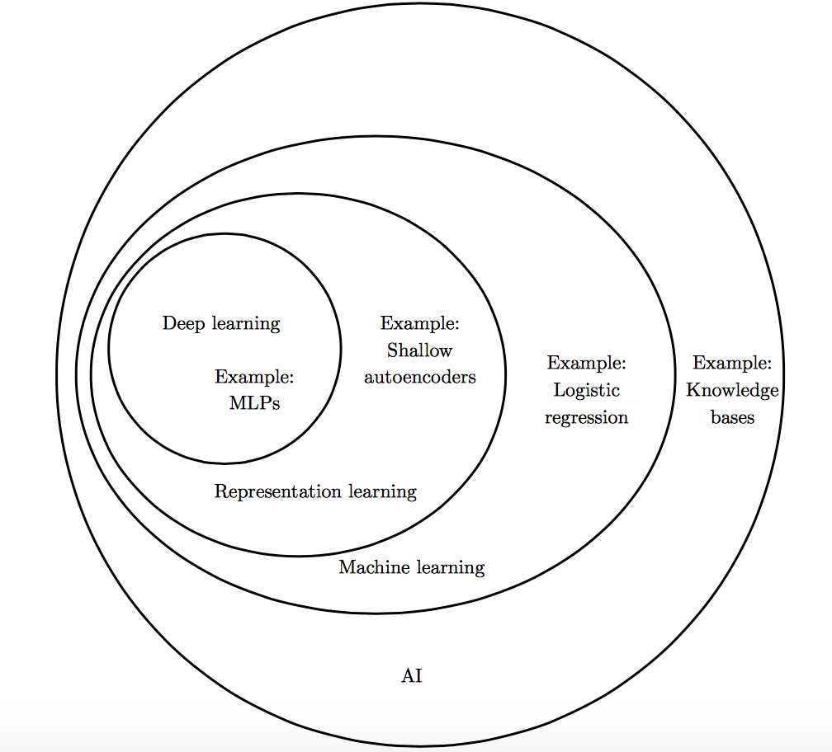
Deep Learning vs Classical ML
(Goodfellow 2016)

Slide 13
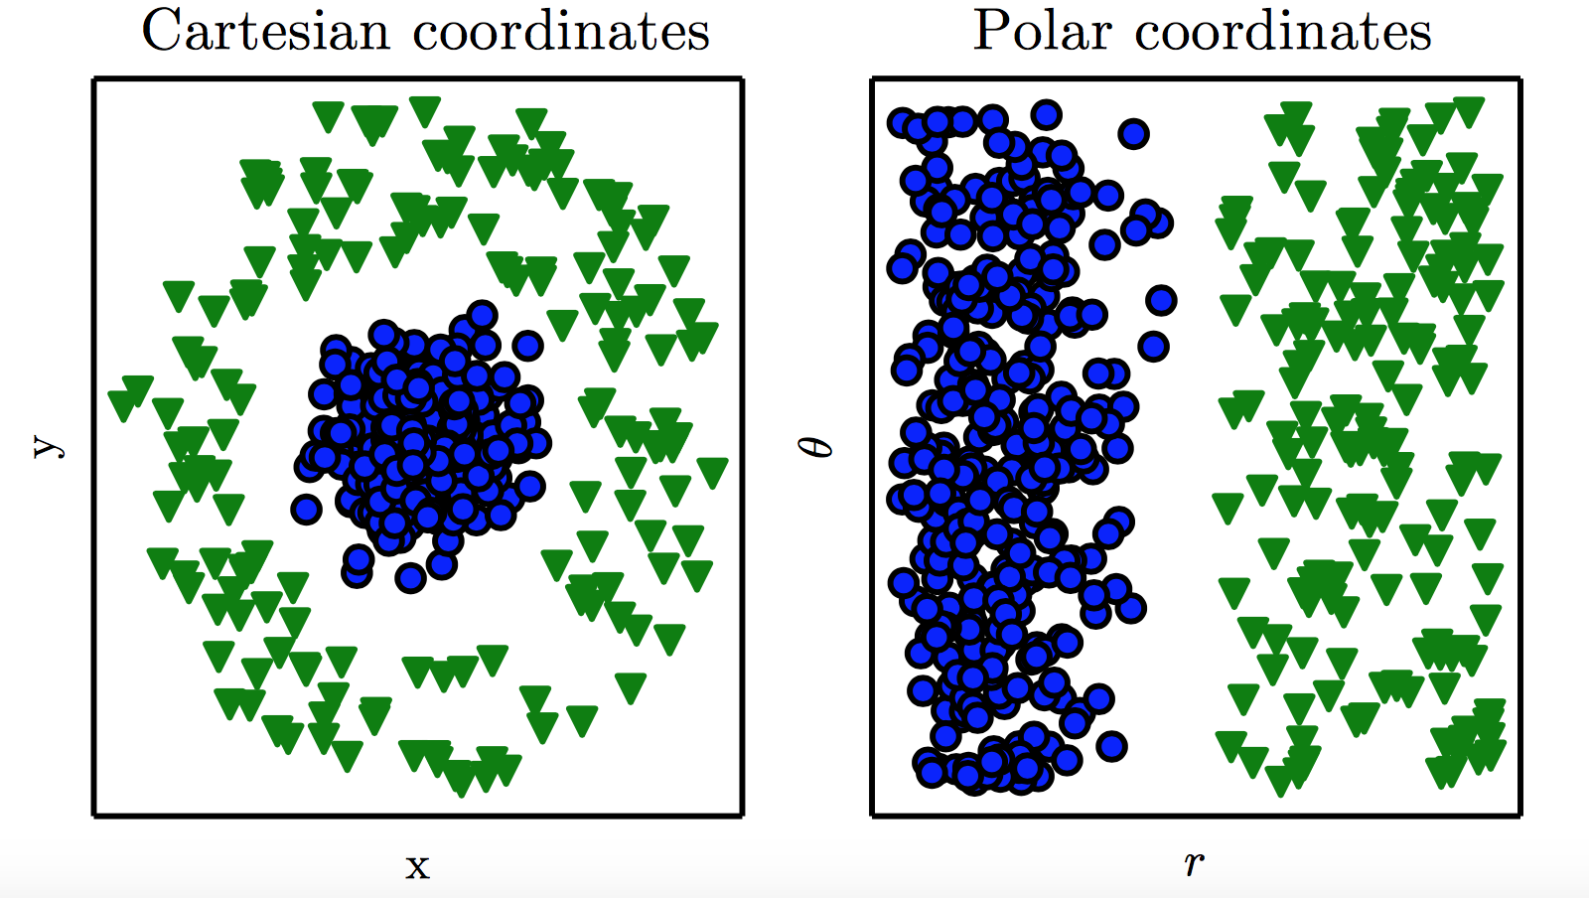
Representation Matters
(Goodfellow 2016)

Slide 14
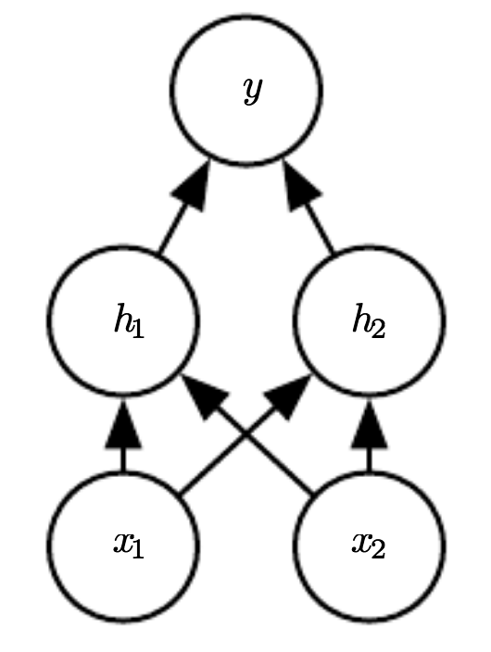
Neural Network

Slide 15
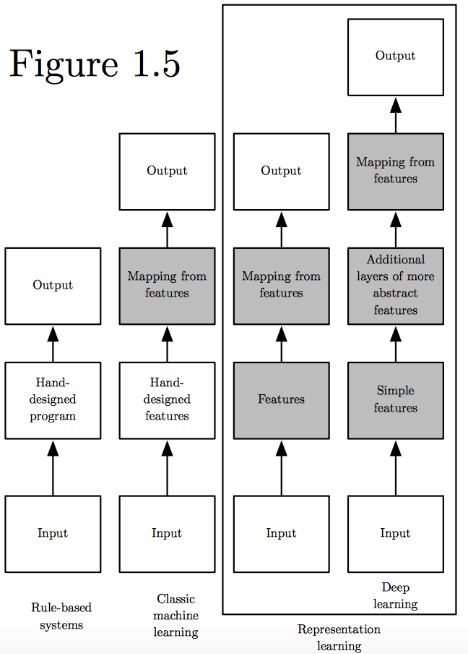
Learning Multiple Components
(Goodfellow 2016)

Slide 16
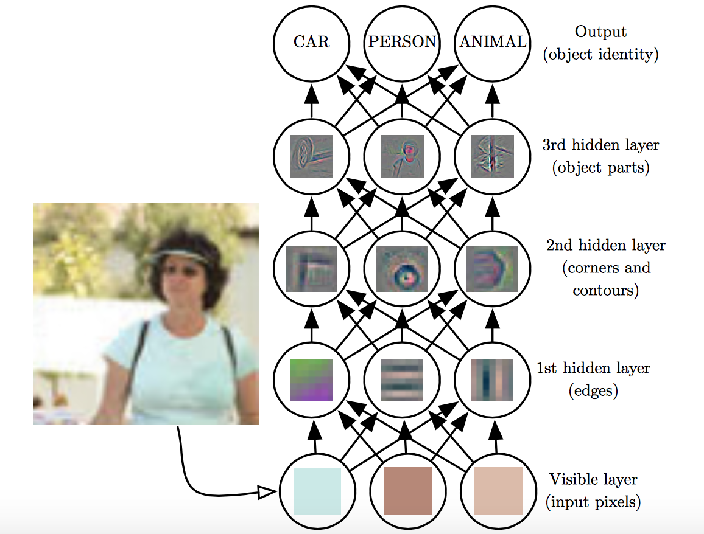
Depth = Repeated Compositions
(Goodfellow 2016)

Slide 17
Beyond Linear Models
Linear models
Can be fit efficiently (via convex optimization)
Limited model capacity
Alternative:
where is a non-linear transform

Slide 18
Traditional ML
Manually engineer
Domain specific, enormous human effort
Generic transform
Maps to a higher-dimensional space
Kernel methods: e.g. RBF kernels
Over fitting: does not generalize well to test set
Cannot encode enough prior information

Slide 19
Deep Learning
Directly learn
where are parameters of the transform
defines hidden layers
Non-convex optimization
Can encode prior beliefs, generalizes well

Slide 20
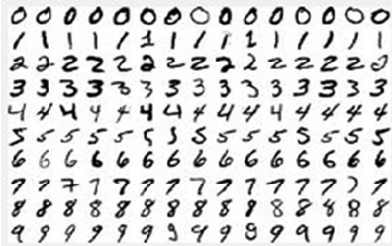
SVM vs Neural Networks
Hand-written digit recognition: MNIST data
See illustration in notebook

Slide 21
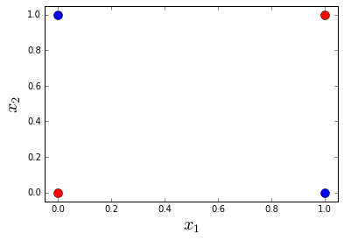
Example: Learning XOR
Optimal linear model (sq. loss)
Predicts 0.5 on all points

Slide 22
Example: Learning XOR
where,
See illustration in notebook

Slide 23
Design Choices
Cost function
Output units
Hidden units
Architecture
Optimizer

Slide 24
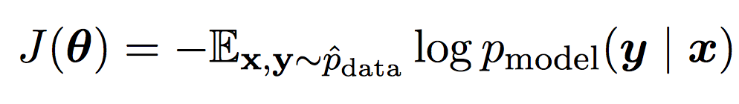
Cost Function
Cross-entropy between training data and model distribution (i.e. negative log-likelihood)
Do not need to design separate cost functions
Gradient of cost function must be large enough

Slide 25
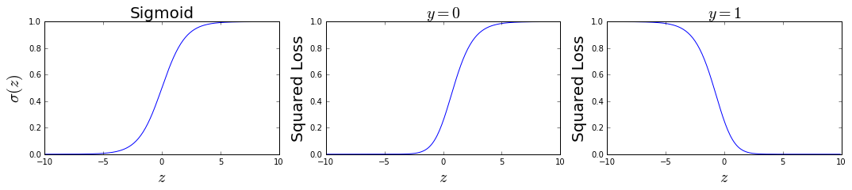
Cost Function
Example: sigmoid output + squared loss
Flat surfaces

Slide 26
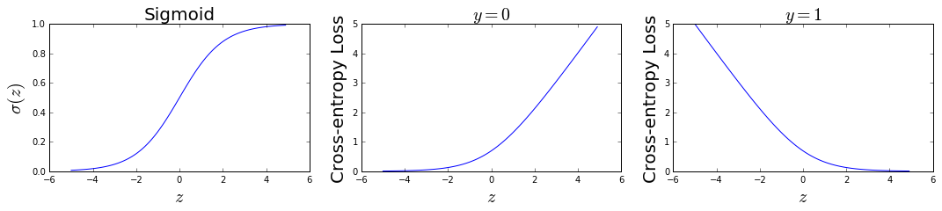
Cost Function
Example: sigmoid output + cross-entropy loss
log undoes exp
Saturates only when the model makes correct predictions

Slide 27
Design Choices
Cost function
Output units
Hidden units
Architecture
Optimizer

Slide 28
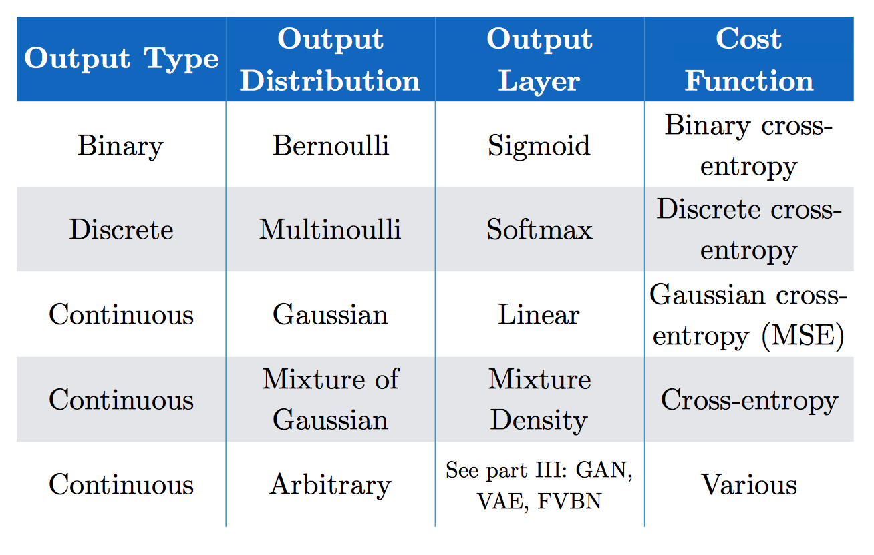
Output Units
(Goodfellow 2017)

Slide 29
Softmax Output
Discrete / Multinoulli output distribution
For output scores z₁, …, z_{n}
Log-likelihood undoes exp
(Score to target label – Maximum score)

Slide 30
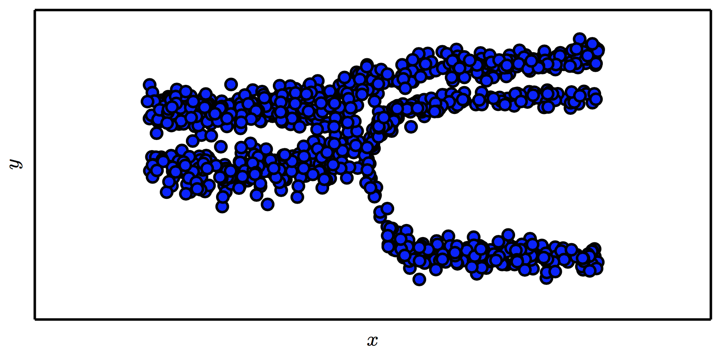
Mixture Density Output
(Goodfellow 2017)

Slide 31
Design Choices
Cost function
Output units
Hidden units
Architecture
Optimizer

Slide 32
Hidden Units
with activation function g
Ensure gradients remain large through hidden unit
Preferred: piece-wise linear activation
Avoid sigmoid/tanh activation
Do not provide useful gradient info when they saturate

Slide 33
ReLU
Rectified Linear Units
Gradient is 1 whenever unit is active
More useful for learning compared to sigmoid
No useful gradient information when z<0
0

Slide 34
Generalized ReLU
Generalization: For ,
E.g. Absolute value ReLU:
0

Slide 35
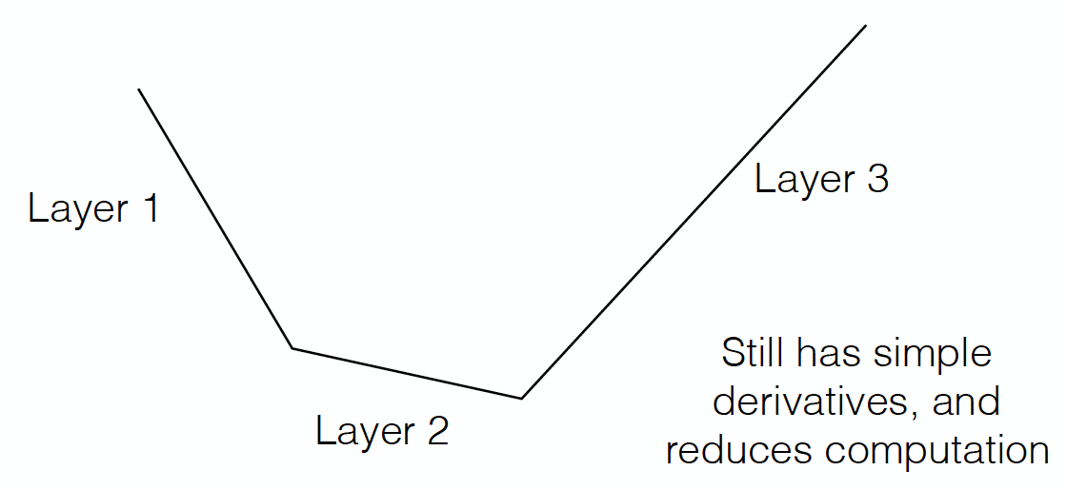
Maxout
Directly learn the activation function
Max of k linear functions
(α₁, β₁)
(α₃, β₃)
Line 3
(α₂, β₂)

Slide 36
Design Choices
Cost function
Output units
Hidden units
Architecture
Optimizer

Slide 37
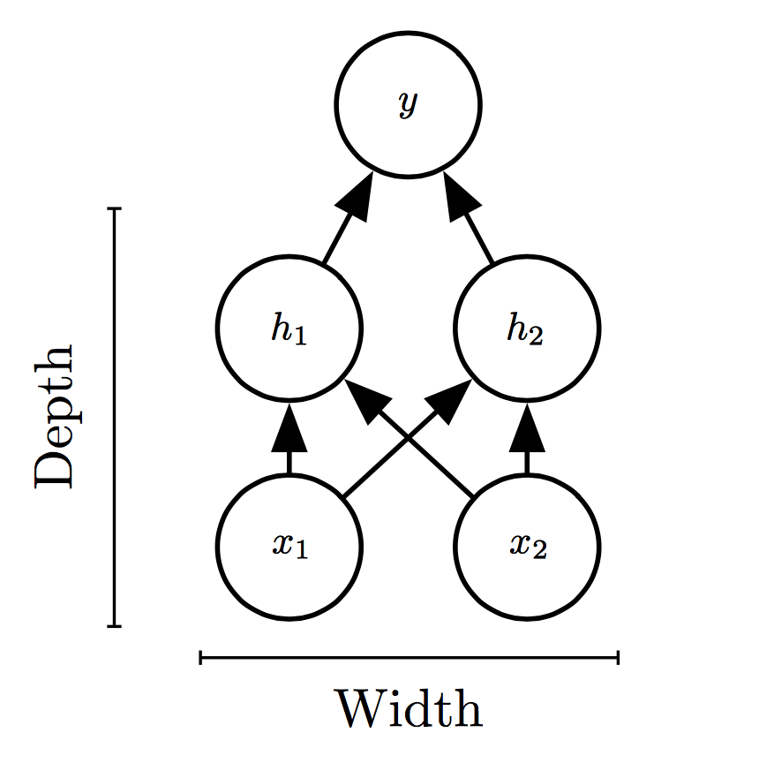
Universal Approximation Theorem
One hidden layer is enough to represent an approximation of any function to an arbitrary degree of accuracy
So why deeper?
Shallow net may need (exponentially) more width
Shallow net may overfit more

Slide 38
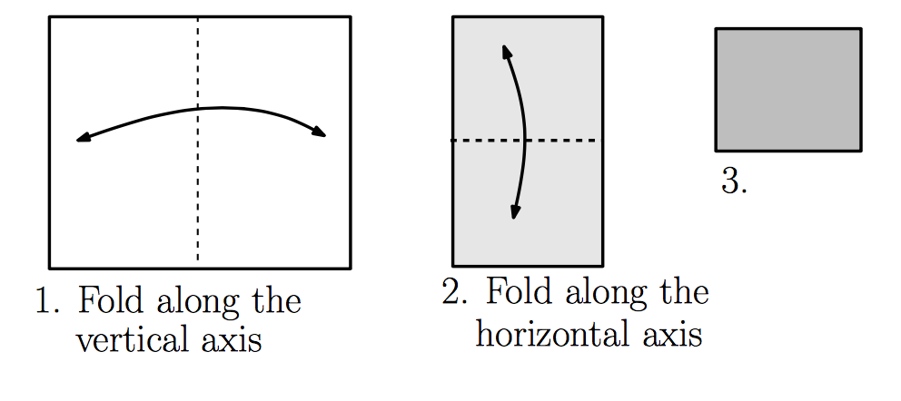
Exponential Gain with Depth
Each hidden layer folds the space of activations of the previous layer. E.g. abs activation
Montúfar (2014)

Slide 39
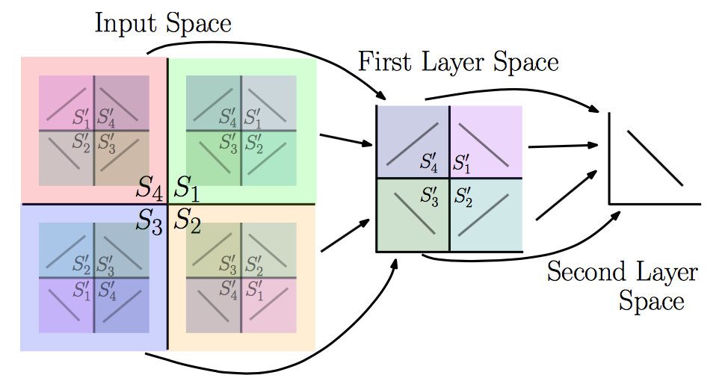
Exponential Gain with Depth
With N hidden layers, there are O(4^{N}) piecewise linear regions
Montúfar (2014)
See illustration in notebook

Slide 40
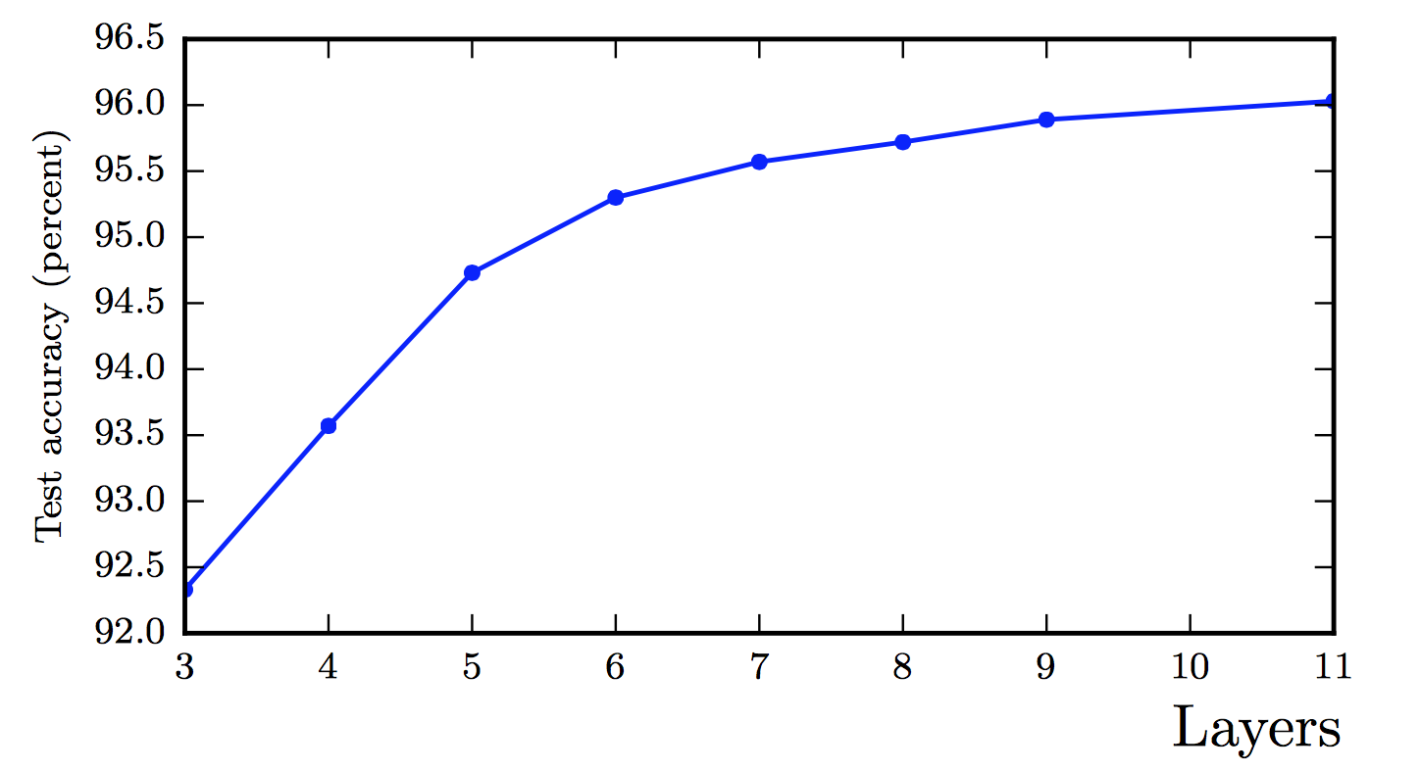
Better Generalization with Depth
(Goodfellow 2017)

Slide 41
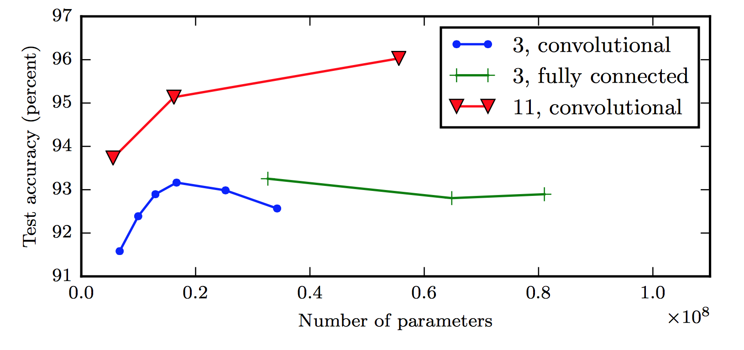
Large, Shallow Nets Overfit More
(Goodfellow 2017)

Slide 42
Design Choices
Cost function
Output units
Hidden units
Architecture
Optimizer

Slide 43
Gradient-based Optimizer (e.g. stochastic gradient descent)
“Chain rule” for computing gradients:
For deeper networks
Naïve computation takes exponential time

Slide 44
Backpropagation
Avoids repeated sub-expressions
Uses dynamic programming (table filling)
Trades-off memory for speed

Slide 45
Backprop: Arithmetic
Jacobian-gradient products
grad w.r.t. x
Jacobian of ‘g’
grad w.r.t. z
Apply recursively!

Slide 46
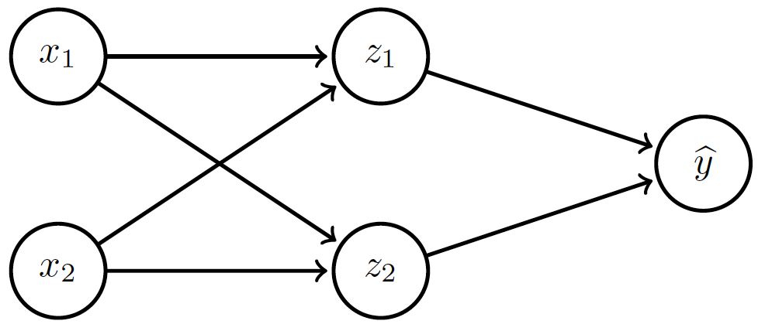
Backprop: Overview
Forward prop: compute activations
Compute loss
Back-prop: compute derivatives

Slide 47
Backprop: Example
Linear activation functions
No bias
Squared loss

Slide 48
Backprop: Example
Forward prop: Propagate activations to output layer

Slide 49
Backprop: Example
Backward prop: Compute loss and its derivative

Slide 50
Backprop: Example
Backward prop: Compute derivatives w.r.t. weights c₁ and c₂

Slide 51
Backprop: Example
Backward prop: Compute derivatives w.r.t. weights c₁ and c₂

Slide 52
Backprop: Example
Backward prop: Propagate derivative to hidden layer

Slide 53
Backprop: Example
Backward prop: Compute derivatives w.r.t. weights a₁, a₂, b₁ and b₂

Slide 54
Backprop: Example
Backward prop: Compute derivatives w.r.t. weights a₁, a₂, b₁ and b₂

Slide 55
Backprop: Example

Slide 56
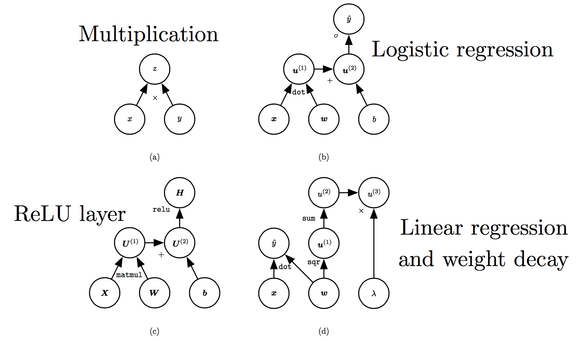
Computation Graphs
(Goodfellow 2017)

Slide 57
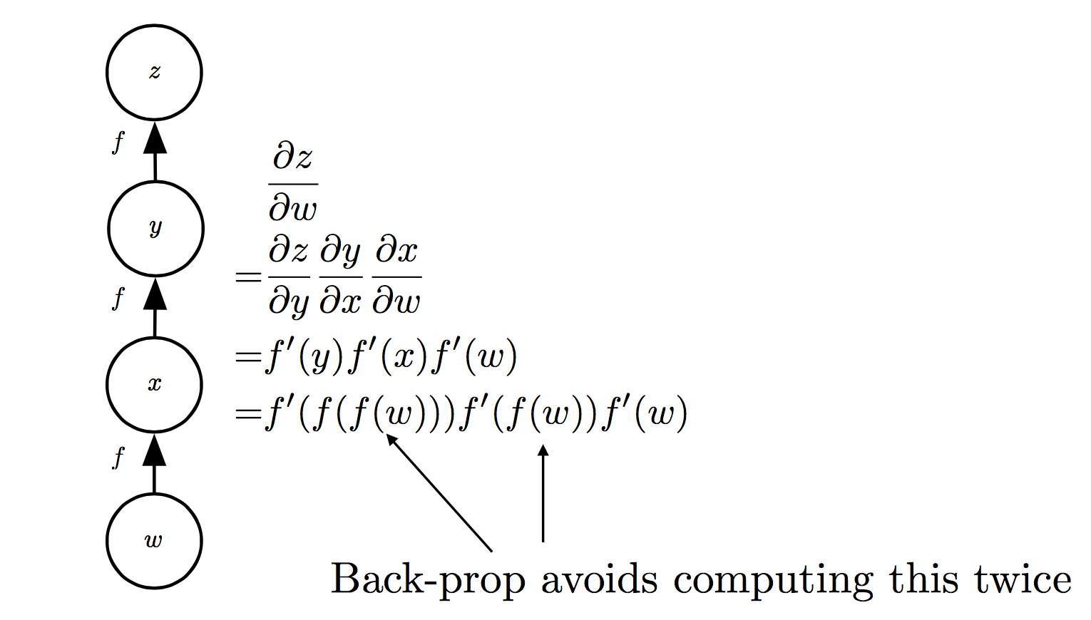
Repeated Sub-expressions
(Goodfellow 2017)

Slide 58
Backprop on Computation Graph
Maintain grad table
Parents of u^{i}

Slide 59
Symbol-to-symbol Differentiation
Derivatives as computation graphs
Same language for both forward and back-propagation
During execution, replace symbolic inputs with numeric value
Used by Theano and TensorFlow
Symbol-to-number differentiation: e.g. Torch and Caffe

Slide 60
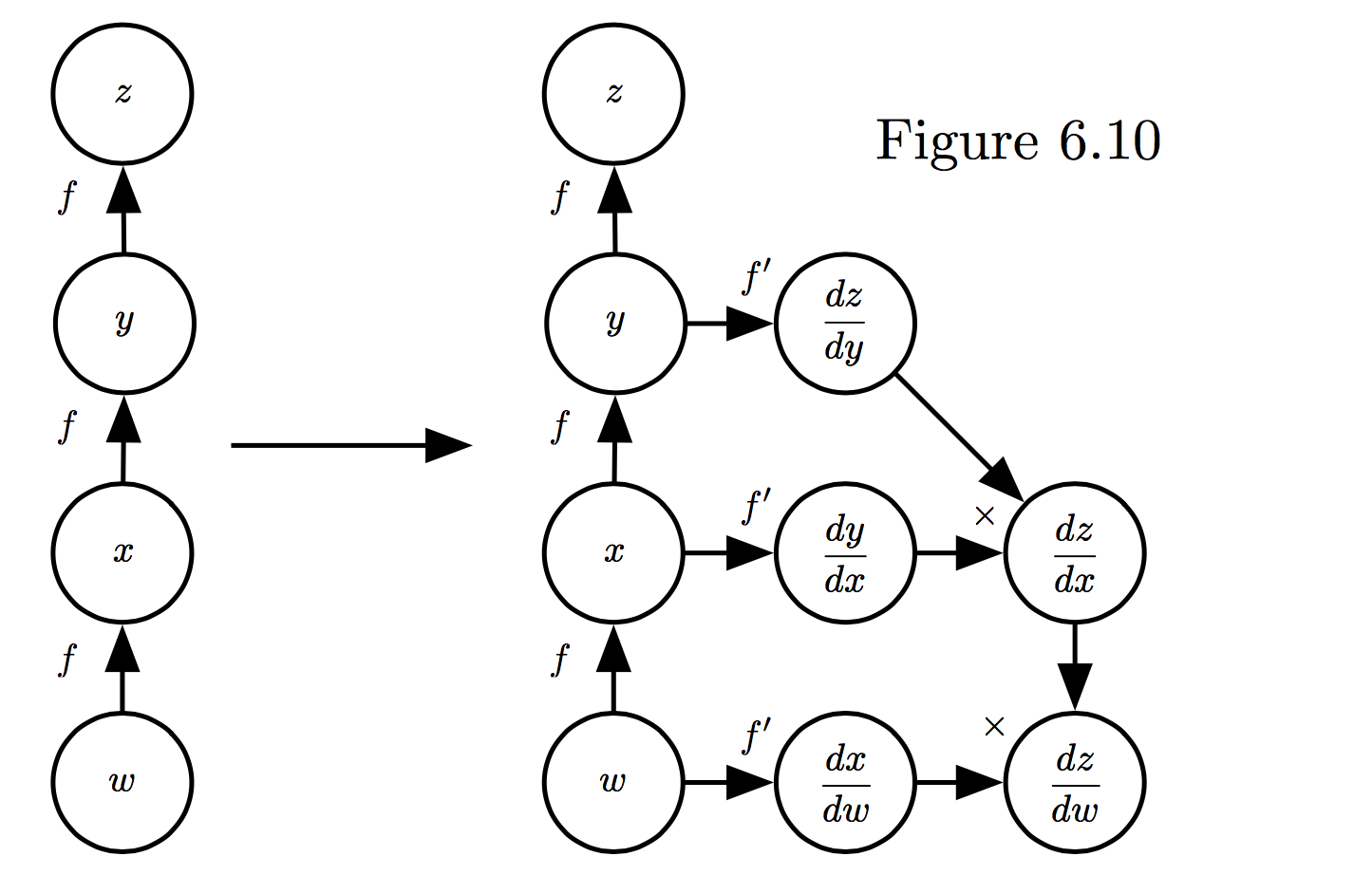
Symbol-to-symbol Differentiation
(Goodfellow et al. 2017)

Slide 61
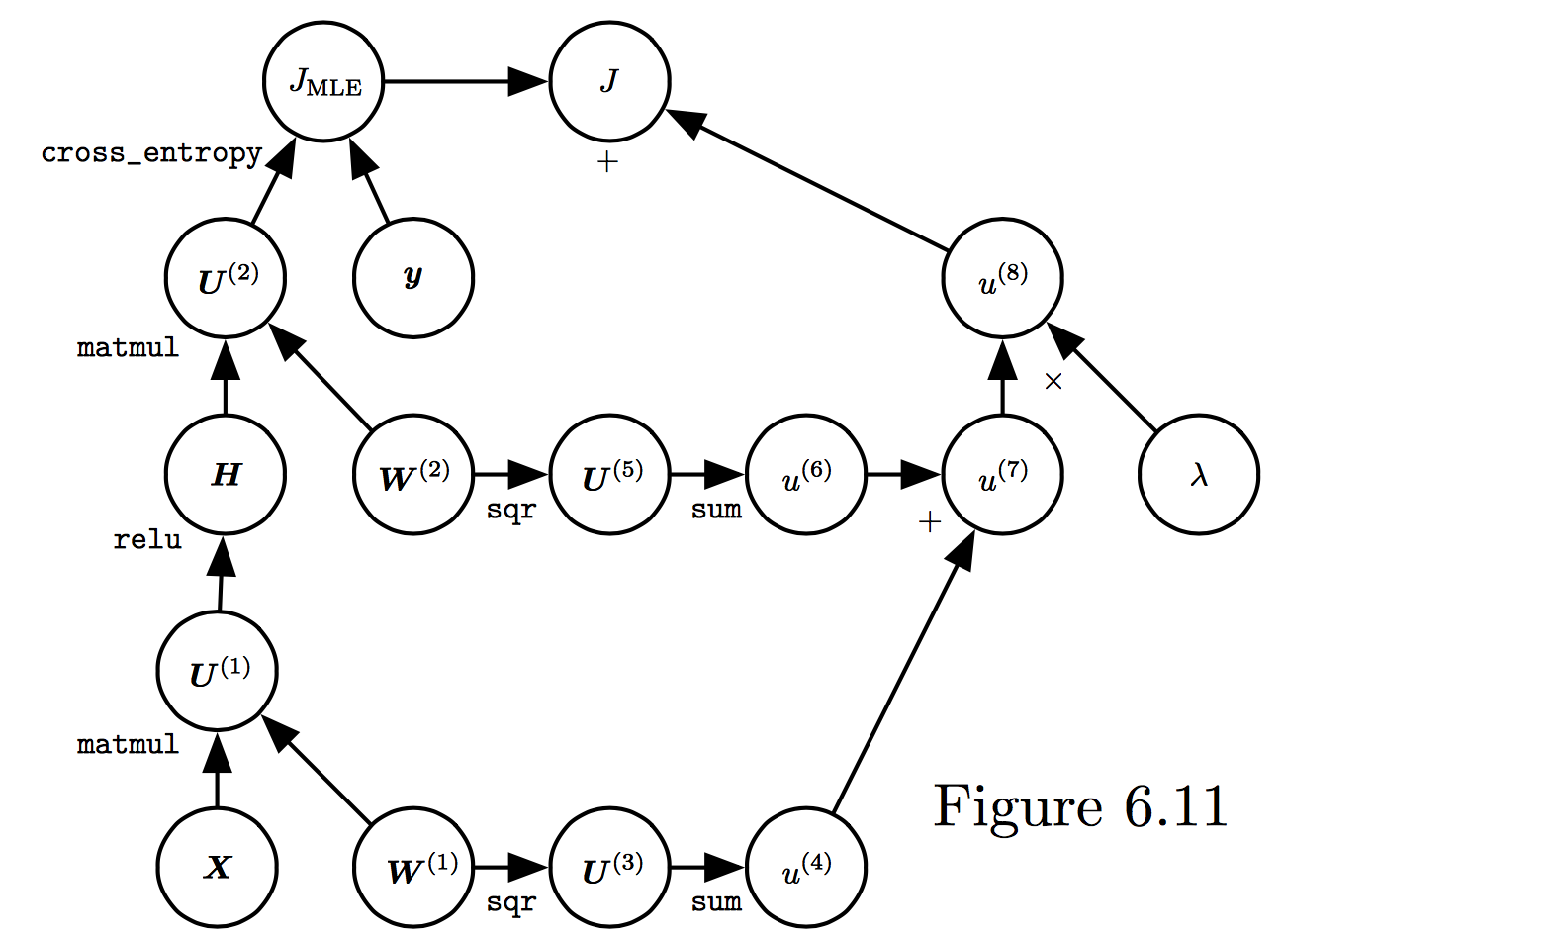
Training Feed-forward Nets
Computational cost for forward/back prop: O(#num-weights)
Memory cost:
O(#num-layers x minibatch-size)
(Goodfellow et al. 2017)

